Slide 1
Recommender system in SVD
By
Nehal Pawar

Slide 2
The real-world application problems with a solution of matrix completion.
Recover Corrupted Data in Sensor Networks: A Matrix Completion Solution: Affected by hardware and wireless conditions in WSNs, raw sensory data usually have notable data loss and corruption. In this a novel approach based on matrix completion (MC) to recover the successive missing and corrupted data is used by analyzing a large set of weather data collected.
On Traffic Matrix Completion in the Internet: The ability of an ISP to infer traffic volumes that are not directly measurable can be useful for research, engineering, and business intelligence. This values that are not directly measurable are calculated using MC.
Water Treatment Data: Cyber-Physical Systems (CPS) have revolutionized water management in urban areas. CPS technologies in general, and Wireless Sensor Networks (WSNs) in particular would suffer from a series of industrial monitoring constraints, which would inevitably lead to missing measurements.

Slide 3
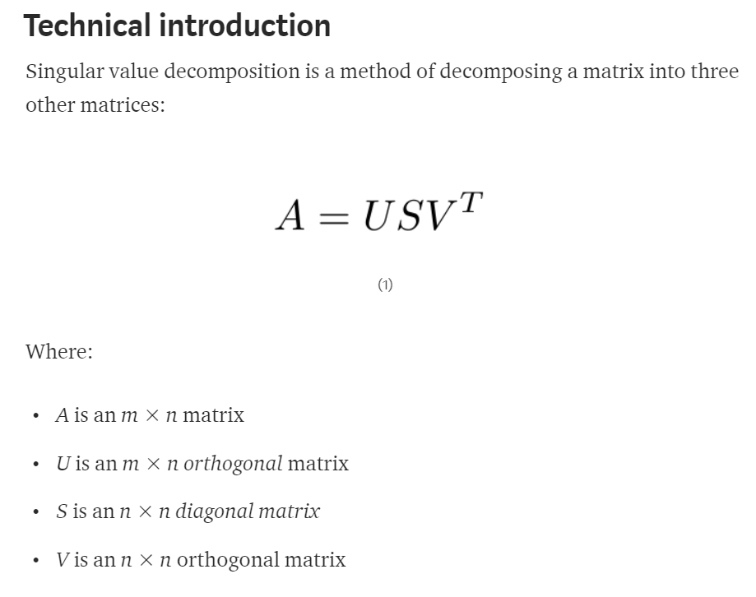

SVD Implementation – python-surprise library

Slide 4
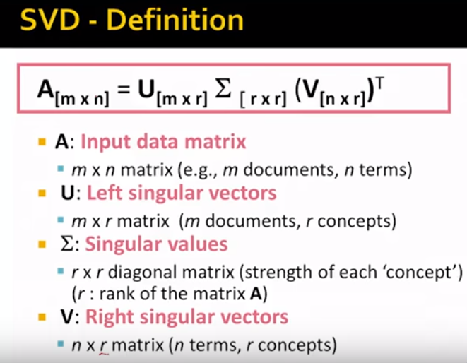

User items
User
Diagonal structure Concepts, non negative Singular values, Descending order
items

Slide 5
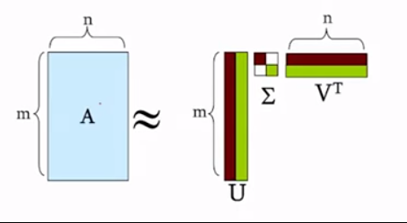

SVD

Slide 6
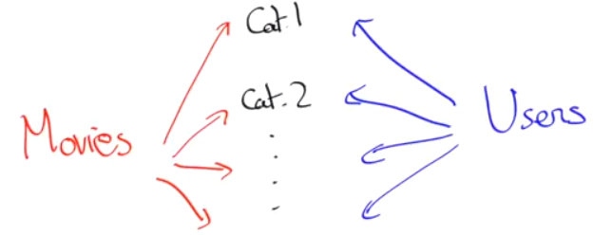
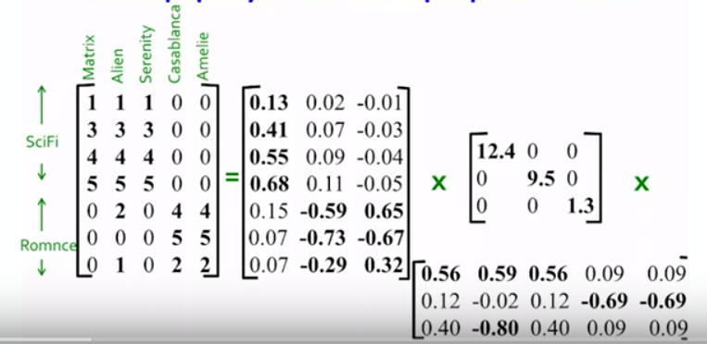

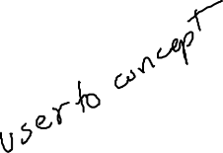
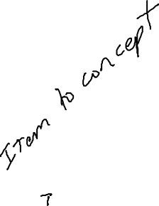

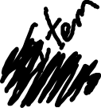


Slide 7
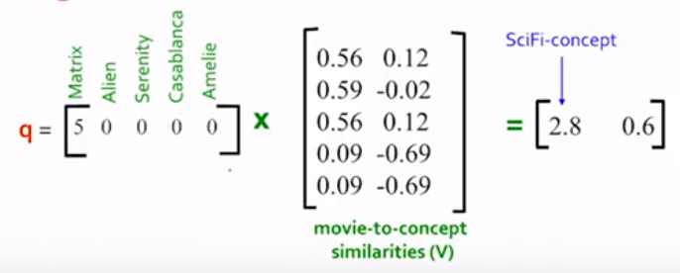

Location of user in concept space: matching category: or who are near neighbors.

Slide 8
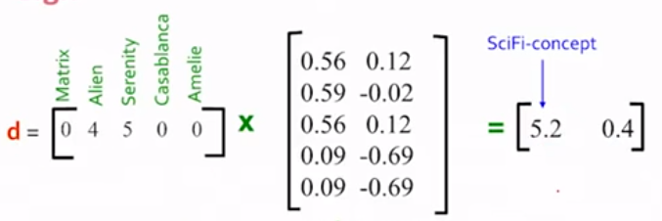
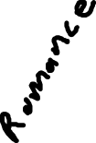




Slide 9
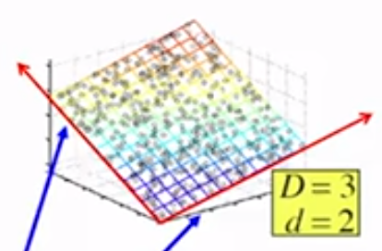



Slide 10
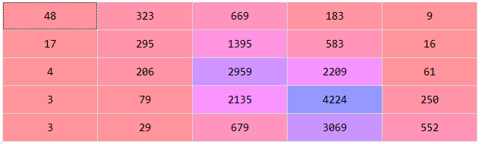

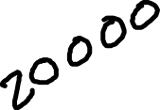


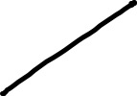



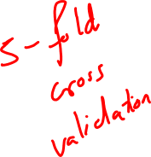
Evaluation results
Confusion Matrix
from sklearn.metrics import confusion_matrix
cm = confusion_matrix(originalraitings, predictedraitings)

Slide 11
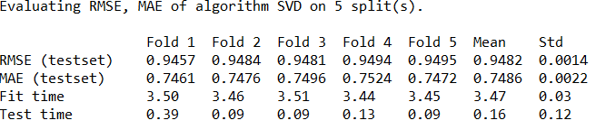

Surprise.accuracy.rmse=RMSE: 0.5879
Surprise.accuracy.mae =MAE: 0.4621

Slide 12
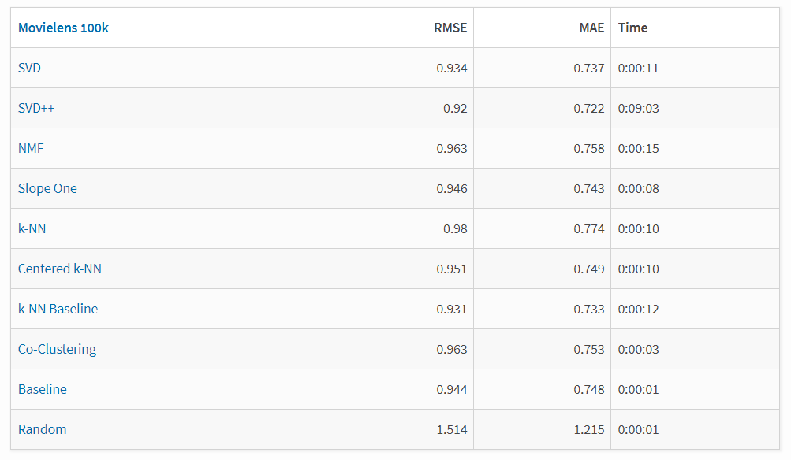

Reason to chose SVD
https://pypi.org/project/scikit-surprise/

Slide 13
Thank You

